Slide 1

Classification of Digital Logical Circuits Using Conditional Random Fields and Support Vector Machines
Anton Bakalov
Sketchers 2007

Slide 2
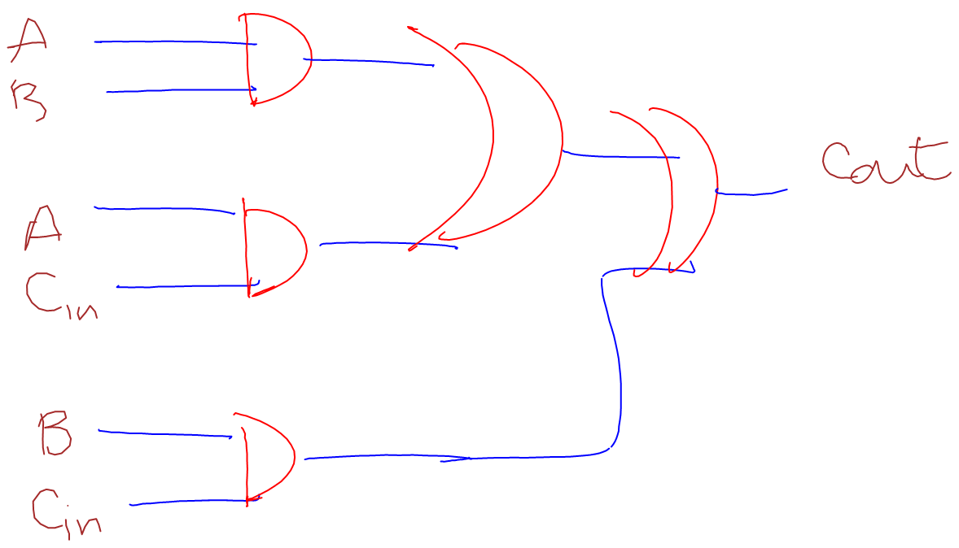
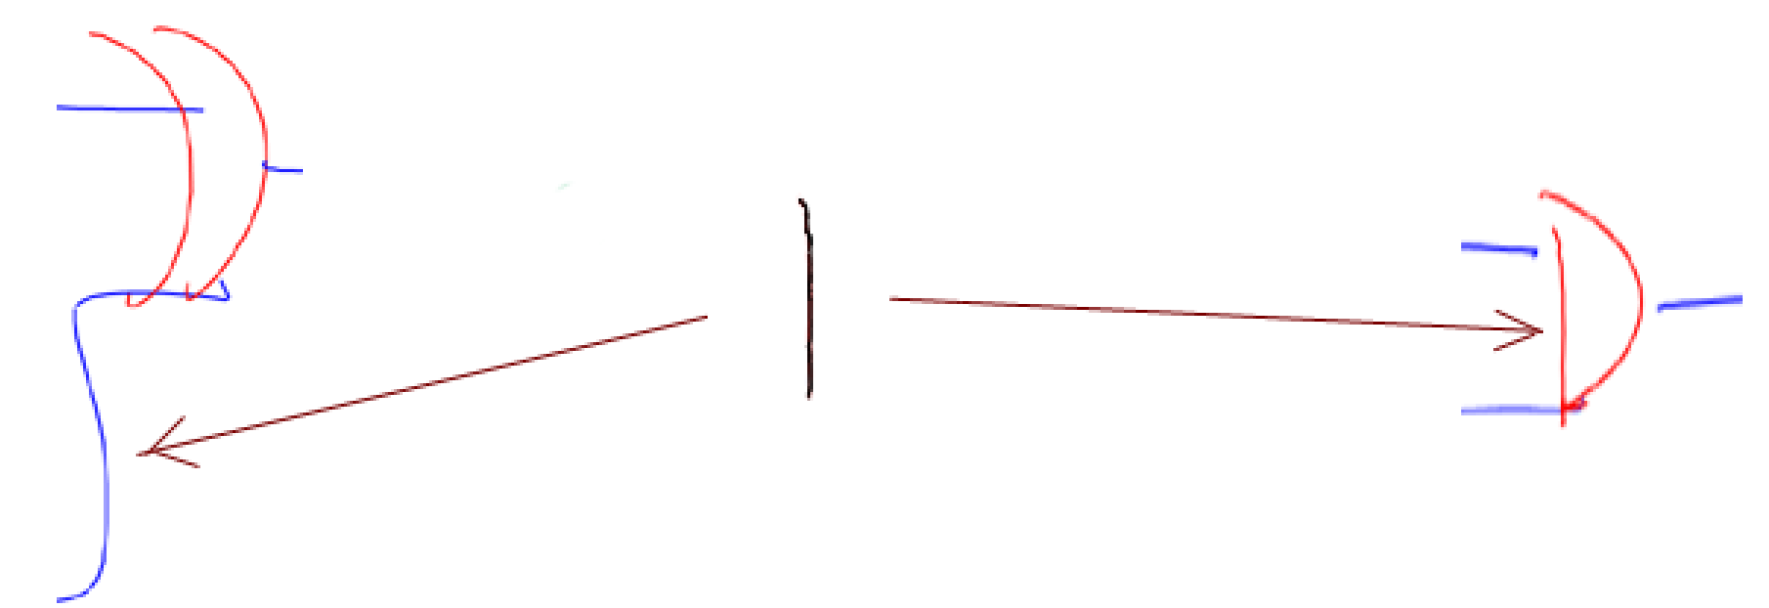
Motivation/Problem:
Goal:
Why do we need a stroke-level classification?
Why use Conditional Random Fields?
Context

Slide 3
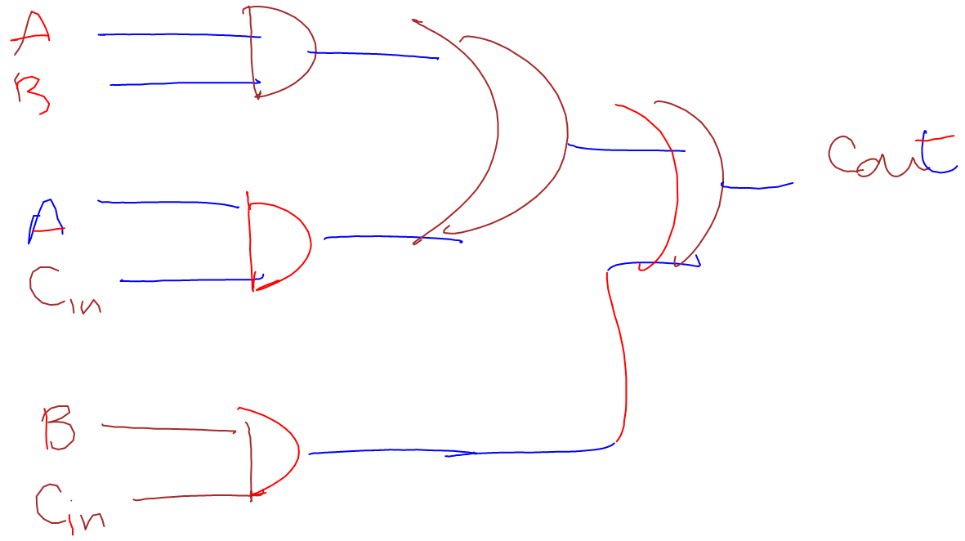
Motivation/Problem (cont.):
Good results for a two-way classification (e.g wire-gate). Not as good ones for a three-way classification.
Labels and Gates have similar characteristics
Inference algorithm does not converge to the correct marginals

Slide 4
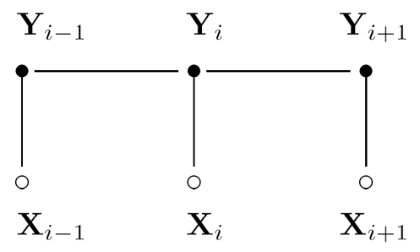



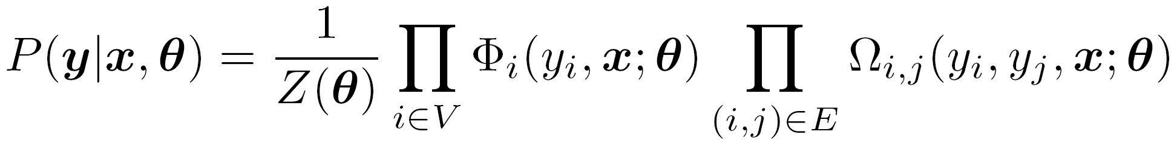
Conditional Random Fields:
A graphical model used to find P(y|x) where x is a set of input data and y is a set of labels. Consists of:
A graph:
Potential functions:
- Site:
- Interaction
can be factored into a product of these potential functions as follows:

Slide 5
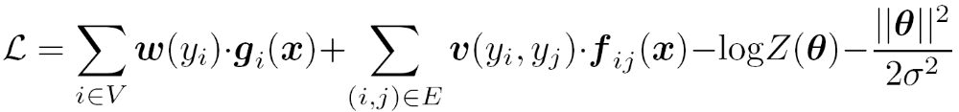

Conditional Random Fields (cont.):
Training – finding the set of parameters that maximizes the log of the likelihood:
Inference – finding by using Loopy Belief Propagation which is an approximate inference algorithm for graphs with loops

Slide 6
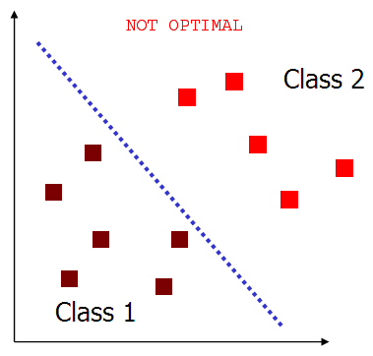
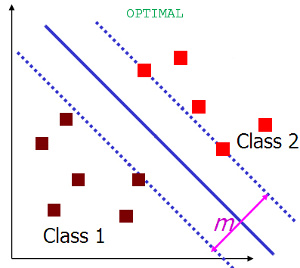
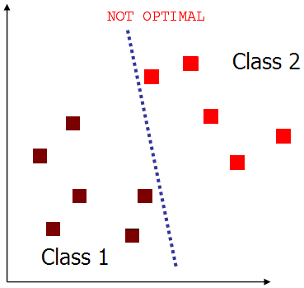
Support Vector Machines:
Training – finding a hyperplane maximizing the margin m
Inference

Slide 7
Approach:
Types of classifications tested with CRF and SVM:
Gate-nongate followed by wire-label
Wire-nonwire followed by gate-label
Label-nonlabel followed by wire-gate
For each classification we examined:
“Locking” labels during inference
Varying the sets of interaction and site feature functions, and the threshold parameters they use
Feature functions using info from the first stage of classification

Slide 8
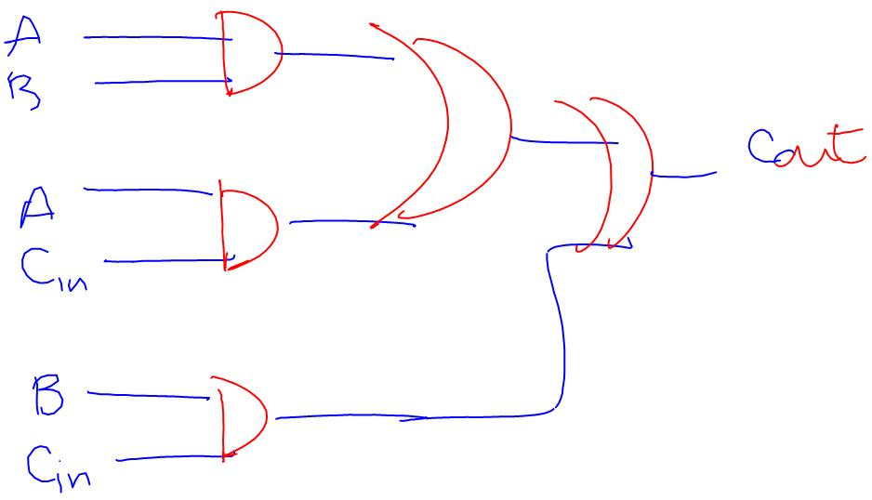
Results from the most accurate clasification:
Gate-nongate (CRF) and Wire-label (SVM)
Gate-nongate
Accuracy: Gate: 76.360 %
Nongate: 83.146%

Slide 9
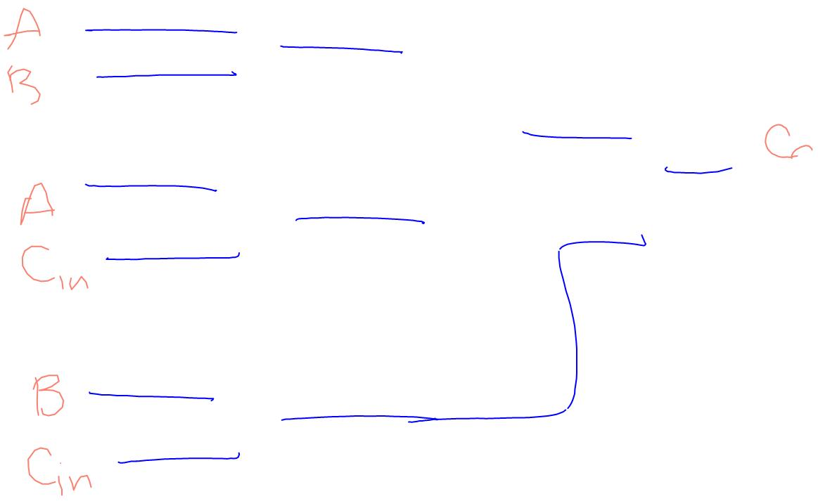
Results from the most accurate clasification:
Gate-nongate (CRF) and Wire-label (SVM)
Wire-label
Accuracy: Wire: 84.800%
Label: 84.253%

Slide 10
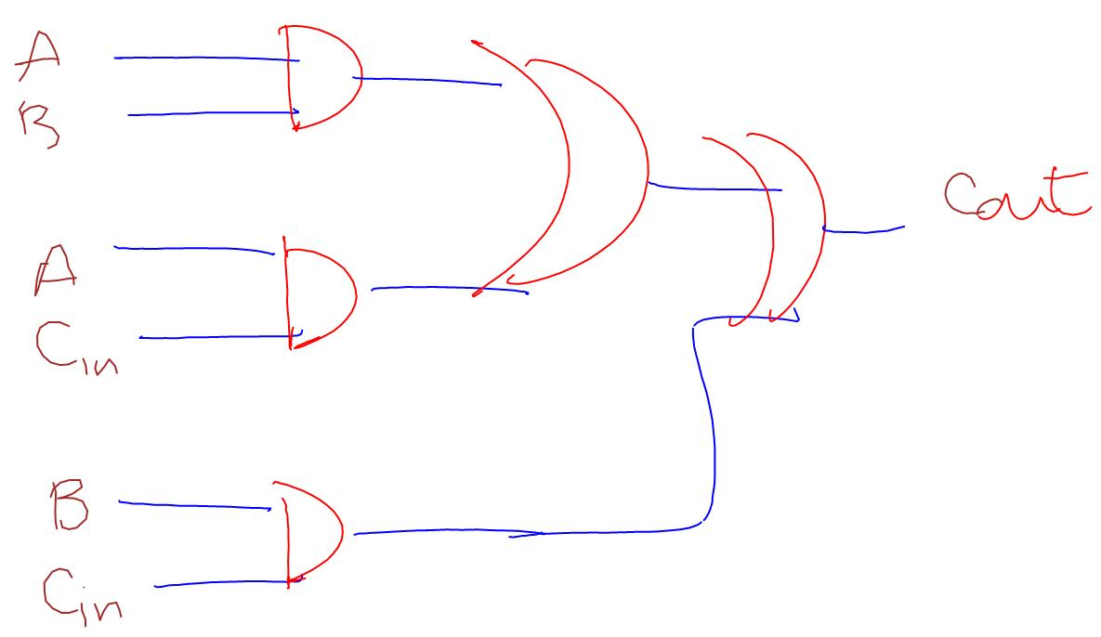
Results from the most accurate clasification:
Gate-nongate (CRF) and Wire-label (SVM)
Gate-nongate
Accuracy: Gate: 76.360 %
Nongate: 83.146%
Wire-label
Accuracy: Wire: 84.800%
Label: 84.253%
Overall accuracy: 72.142%

Slide 11
Improvements/future work:
Implementing an inference algorithm alternative to Loopy Belief Propagation (LBP)
LBP is not guaranteed to converge
Even if it does, it is not guaranteed to converge to the correct marginal probabilities

Slide 12
Acknowledgements:
Prof. Alvarado and Prof. Harris
Sketchers research group
Funded by NSF career grant

Slide 13

Questions

